Slide 1

Leading an Inclusive Municipality
Presenter: Mayor Amanda McDougall

Slide 2



Presentation Topics
A bit about myself
Barriers within
Making Change
Hope for the future

Slide 3
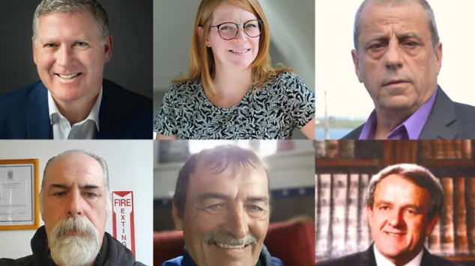
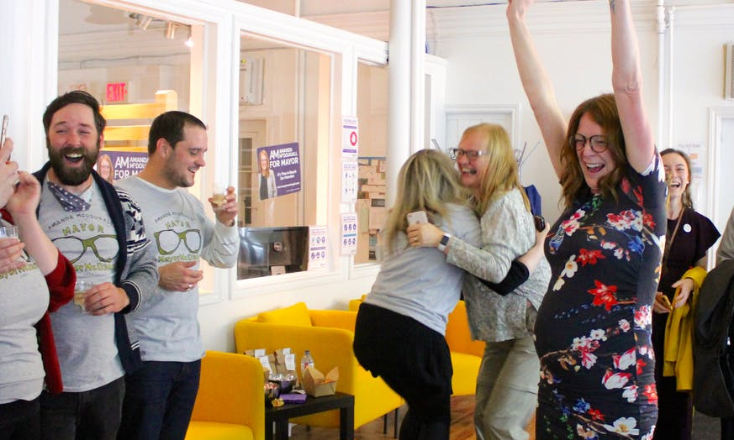
Mayor McDougall
Road to the Mayor’s Office
Building experience
Goals
The campaign
A baby in office

Slide 4
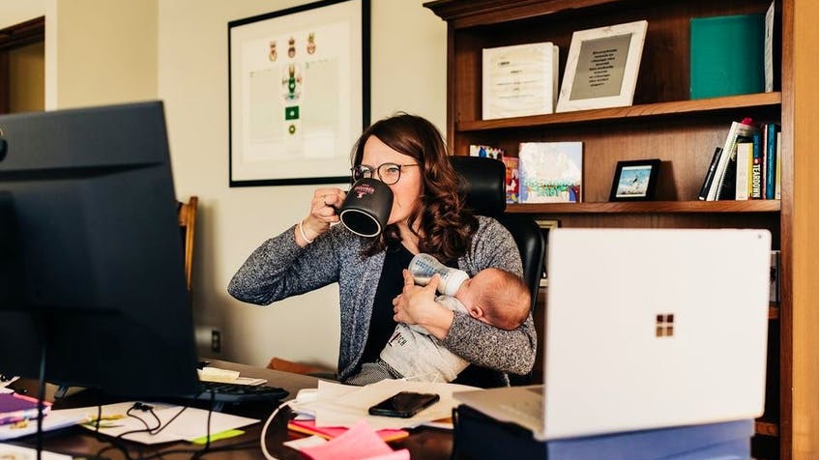
Barriers Within
Being the first
Being a mom
Being a mom of a child with different abilities
Being a living example of change
Being bullied

Slide 5
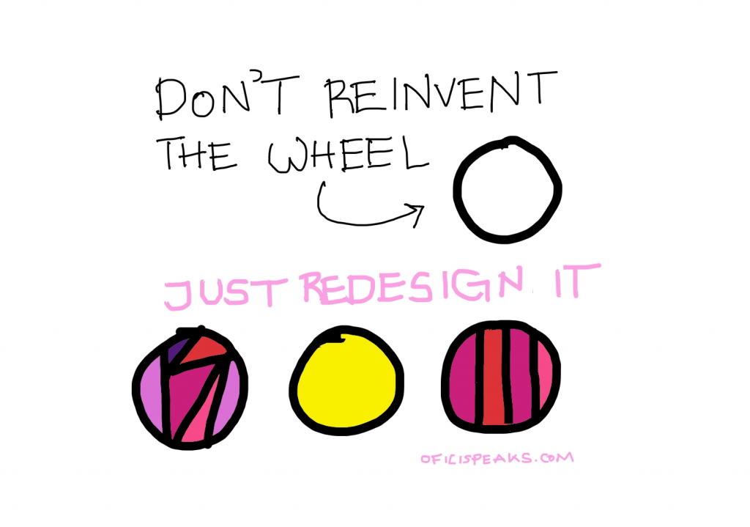
Making Change
Making City Hall open to all
Listening to Committees
Research and Consultation
Partnerships in community

Slide 6

Hope for the future
Q&A

